Slide 1
Richland AYSO 2023
Player/Parent Meeting

Slide 2
Before We Begin….
Except for the restrooms, please do not leave the room or wander in the hallway
(we are guests of Richland School and responsible for any damages)
PLEASE no horseplay in the hallways

Slide 3
What Is the Kids Zone?
Three parts
Field signs
Kids zone buttons
Pledge

Slide 4
AYSO Websites/Facebook
richlandayso.com
Richland AYSO – On Facebook
RichlandAYSO@yahoo.com
Visit us on the web…

Slide 5
Communication Tools - Phone Richland AYSO One Call
We can have up to 2 numbers called per player.
If you would like another number added or need to change one, please email richlandayso@yahoo.com.
If you ever need to hear the latest one call message you received on your phone you can call 1-877-698-3261, then press 1.

Slide 6
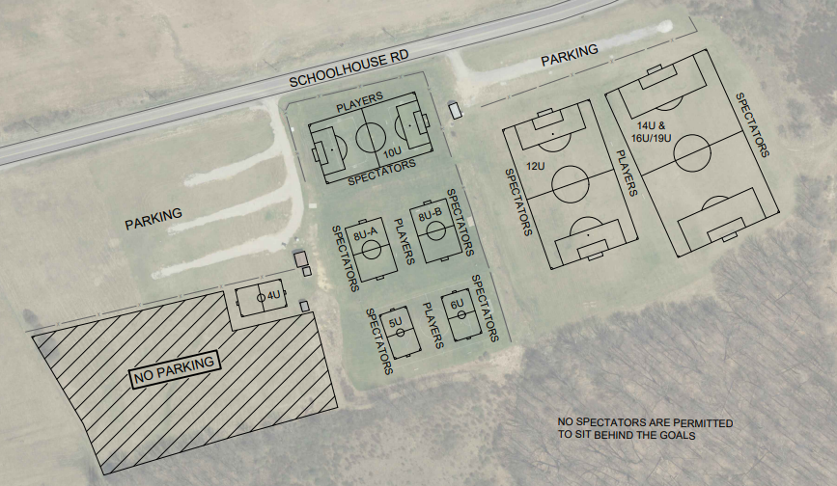
Field Information

Slide 7
Important Dates 2023
Field Day/Coach Equip. pickup Saturday – April, 15th begin 9AM
Full Referee Training–Saturday, April 15th-Mt Calvary Church 8AM
1st day of Practices – Week of Monday, April 17th
Soccerfest Picture Day – Saturday, April 22nd
1st day of Games – Week of Monday May 3rd
Richland AYSO Soccer Tournament – Saturday, June 10th
Free in Person Coach Training – 6U, 8U, 10U, & 12U – Email us at richlandayso@yahoo.com

Slide 8
Soccerfest / Picture Day
Saturday, April 22nd – Starting at 9am
Team picture will be scheduled for each team
½ hour after pictures team will play game vs willing parents. Game will be 2(10) minute halves.
4U/5U – 10U Age Groups Only
Dunkin Donuts will be at the field and will be giving out free coffee from 11am – 2pm.

Slide 9
Points of Emphasis
Shin guards must be under the socks and completely covered by socks. You can not put the shin guard over the sock and fold it over.
No jewelry
Band aids or tape covering earrings or starter-studs are NOT allowed.
Spectators must be on opposite side of field as coaches and players. No spectators should be seated behind the goals.
No alcohol, smoking, vaping, or tobacco of any kind is permitted at the fields.
No pets are permitted to be at the fields.
Please do not park next to the porta-john or dumpster.

Slide 10
Coach’s Time
Introduce yourself
Short background
How to reach you (phone, e-mail, address, etc)
Hours when it is OK to call (morning & night)
8U coaches and older. Find a parent on your team willing to take referee course.
Coaches excused 5 minutes early to receive their coach packets.
Coaches that have not registered as volunteer yet or that need to complete child clearances must do so before first practice.

Slide 11
Canceled Games
A certified referee is REQUIRED for 10U and UP!
Coaches please understand
NO ref = NO game
If interested in taking course email us at richlandayso.com.

Slide 12
Questions/Answers

